Slide 1

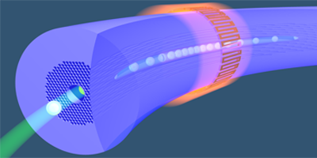
Micro porous core photonic crystal fiber for sensing purpose
Supervised by: | Presented by:
Kawsar Ahmed Assistant Professor | 1. Bikash Kumar Paul (IT-12019) 2. Md. Shadidul Islam (IT-12043)
Department of Information and Communication Technology (ICT)
Mawlana Bhashani Science and Technology University
Santosh, Tangail-1902
Bangladesh

Slide 2
OUTLINES
Objectives
PCF
Classification of PCF
Importance of PCF
Applications of PCF
Guiding properties of PCF
Proposed PCF
Result Analysis
Fabrication of Proposed PCF
Comparison among prior verses proposed PCF
Future Works
Conclusion
References
IT-12019 IT-12043

Slide 3
Objectives
To design and characterization of photonic crystal fiber for chemical sensing application.
To achieve high relative sensitivity.
To gain low confinement loss.
To ensure broad transmission spectrum covering E+S+C+L+U band.
To design simple structure with high performance that reduces the complexity of fabrication process.
IT-12019 IT-12043

Slide 4
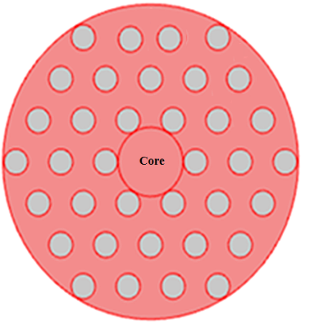
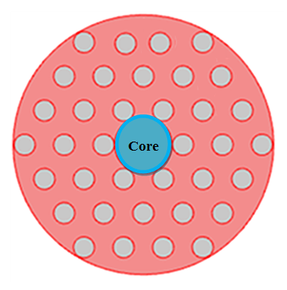
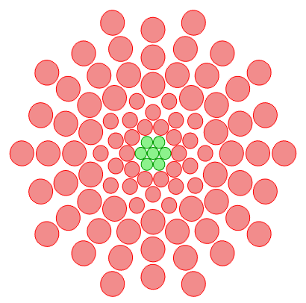
Major PCF Types
Solid-core PCF
Solid core
Guide light by TIR
n_{core} > n_{cladding}
Holey cladding
PBG-Guiding PCF
Guide light by PBG
n_{core} < n_{cladding}
Hollow core
Figure 1 : Different types of PCF
Microstructure Fiber
IT-12019 IT-12043

Slide 5
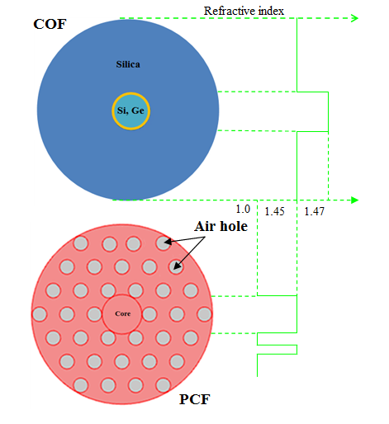
Why PCF?
COF demerits:
Low index contrast
Narrow design space
PCF merits:
Controlling optical properties
Single material fiber
High index contrast
Wider design space
Major demerits :
Confinement losses exist
Fabrication challenge
Connectivity problem with other waveguides and devices.
Short manufacture length and high price of using PCF as transmission media.
Figure 2 :COF and PCF Structure
IT-12019 IT-12043

Slide 6
Applications of PCFs
Index guided PCFs:
High power handling.
Fiber laser multi-wavelength generation.
Super continuum generation applied to optical coherence tomography and to spectroscopy.
Fiber sensor.
High numerical aperture and applied OCT for medical imaging.
Hollow Core PCFs:
High power transmission .
Gas-based nonlinear optics.
Particle guidance in liquids.
Fiber in sensing application.
IT-12019 IT-12043

Slide 7
Principle of absorption spectroscopy(cont..)
If a optical fiber is used as a absorption cell, then above equation can be written as:
Where r is the relative sensitivity coefficient is defined by
The transverse electric and magnetic fields of the mode are respectively introduced by Ex, Ey, and Hx, Hy.
IT-12019 IT-12043

Slide 8
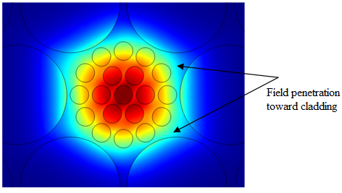
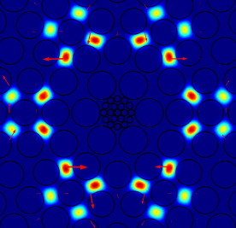
Confinement Loss, Lc
Confinement loss
Due to finite no of air-holes.
Results in signal degradation along the channel.
Confinement Loss,
Here, Im[n_{eff} ] = Imaginary part of the effective refractive index.
= Free space wave number = 2π/λ.
IT-12019 IT-12043

Slide 9
Numerical Aperture(NA) and Effective Area (A_{eff})
Numerical aperture is the properties of the fiber can be calculated by the following equation,
The effective mode area of the proposed PCF structure can be calculated the propagating mode area by given equation,
where, E is the transverse electric field.
IT-12019 IT-12043

Slide 10
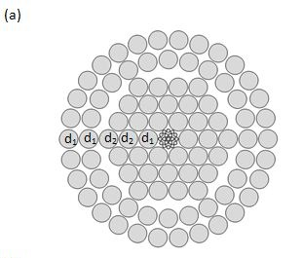
Prior PCF Design 1
Sensitivity - 58.03%
Confinement Loss – 3.71 × 10 10⁻¹¹ dB/m
Core Shape - Porous
Cladding Shape - Hybrid
Bikash Kumar Paul, Md Shadidul Islam, Sawrab Chowdhury, Sayed Asaduzzaman, Kawsar Ahmed, "Porous core Photonic Crystal Fiber based chemical sensor." 9th International Conference on. Electrical and Computer Engineering (ICECE), IEEE, pp. 251-254, 2016.
IT-12019 IT-12043

Slide 11
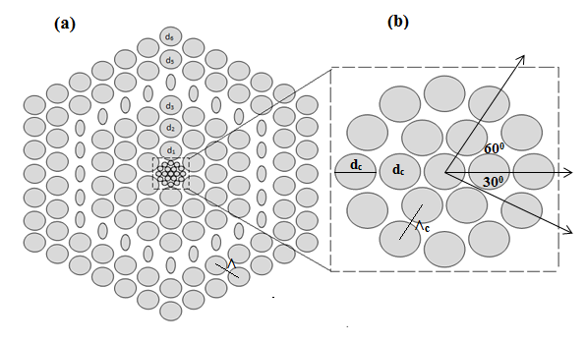
Prior PCF Design 2
Sensitivity - 63.56%
Confinement Loss – 5.56 × 10 10⁻¹¹ dB/m
Core Shape - Porous
Cladding Shape – Hybrid Hexagonal
Kawsar Ahmed, Md Shadidul Islam, and Bikash Kumar Paul. "Design and numerical analysis: Effect of core and cladding area on hybrid hexagonal microstructure optical fiber in environment pollution sensing applications." Karbala International Journal of Modern Science , pp. 1-10, 2017. (Elsevier Publisher)
IT-12019 IT-12043

Slide 12
Proposed PCF
Folded-Circular Porous shape PCF
Hole to hole distance = Ʌ Pitch.
1st and 5th cladding layer diameter is d₁ = d₅
2nd , 4rd cladding layer diameter d₂ = d₄ and 3rd layer is denoted by d_{3.}
No. of Rings in cladding region : 5
Core-hole diameter and pitch are d_{c} and Ʌ_{c} respectively.
Figure 4: Schematic of end-faced of proposed FP-PCF.
IT-12019 IT-12043

Slide 13
Comparatively simple structure
Comparatively simple.
It has no doping , so reduce the complexity.
It contains only 90 air holes in cladding and core holding 19 holes .
It would be easy to fabricate.
Both relative sensitivity and confinement loss are significant than prior PCFs.
IT-12019 IT-12043

Slide 14
Cladding and Core formation depending on
area
Relative Sensitivity
Relative Sensitivity
Figure 5: Relative sensitivity versus wavelength (λ) for different cladding and core area variation.
The relative sensitivity for optimum PCF structure is of 65.02% at 1.55µm
IT-12019 IT-12043

Slide 15
Confinement Loss observation for different area
of cladding and core
Confinement Loss
Confinement Loss
Confinement Loss = 9.44×10⁻⁷ (dB/m)
for Optimum PCF.
Confinement Loss Curve for Optimum PCF.
Figure 6: Confinement loss (Lc) versus wavelength (λ) for different cladding and core area variation.
IT-12019 IT-12043

Slide 16
Investigation of Numerical Aperture (NA) and Effective area (A_{eff} )
Fig. 7. Effective mode area of propagating mode and nonlinear coefficient of optimized FPPCF.
Fig. 8. Numerical aperture of optimized FP-PCF over the communication band range
E + S + C + L + U.
IT-12019 IT-12043

Slide 17
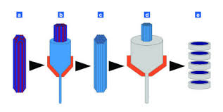



PCF Fabrication Technique
Fabrication Techniques | Figures
Stack and Draw Technique
Selective Filling Technique
Sol-gel Technique
Chemical Vapor Deposition Technique.
IT-12019 IT-12043

Slide 18
Tuning geometric parameter of the structure for measuring tolerance
Relative sensitivity curve for optimum PCF.
Confinement los curve for optimum PCF.
Figure 9: Increasing and decreasing diameter and pitch in the core and cladding reason.
IT-12019 IT-12043

Slide 19
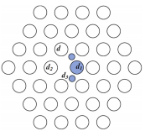
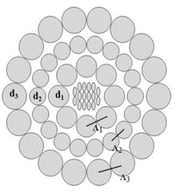
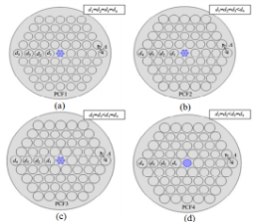
Comparison among prior verses proposed
Comparison Results :
All investigation results obtained at the operating wavelength λ = 1.55 μm
Prior PCF 1 Ref [4] | Prior PCF 2 Ref [5] | Prior PCF 3 Ref [6] | Proposed PCF
Number of rings 3 | Number of rings 3 | Number of rings 4 | Number of rings 5
Sensitivity is 10.56% | Sensitivity is 31.62% | Sensitivity is 40.32% | Sensitivity is 65.02%
Conf Loss = 1.56×10⁻¹ (dB/m) | Conf Loss = 8.75 ×10⁻⁹ (dB/m) | Conf Loss =7.55 ×10⁻⁷ (dB/m) | Conf Loss = 9.47×10⁻⁷ (dB/m)
IT-12019 IT-12043

Slide 20
Sensitivity response comparison among recent journal articles
Proposed PCF is 6.17 times better than Ref.[4]
Proposed PCF is 2.08 times better than Ref.[5]
Proposed PCF is 1.62 times better than Ref.[6]
H .Ademgil, and S .Haxha, “Highly birefringent nonlinear PCF for optical sensing of analytes in aqueous solutions,” Optik-International Journal for Light and Electron Optics.127, 6653-6660(2016). (Elsevier Publisher)
S. Asaduzzaman, K. Ahmed, T. Bhuiyan, T. Farah, Hybrid photonic crystal fiber in chemical sensing, SpringerPlus 5 (1) (Jun. 2016). (Spinger Publisher)
M.F.H. Arif, K. Ahmed, S. Asaduzzaman, M.A.K. Azad, Design and optimization of photonic crystal fiber for liquid sensing applications, Photonic Sensors 6 (3) (2016) 279–288. (Spinger Publisher)
IT-12019 IT-12043

Slide 21
Achivements
Bikash Kumar Paul, Md Shadidul Islam, Sawrab Chowdhury, Sayed Asaduzzaman, Kawsar Ahmed "Porous core Photonic Crystal Fiber based chemical sensor." Electrical and Computer Engineering (ICECE) 9th International Conference on. IEEE, pp. 251-254, 2016.
Kawsar Ahmed, Md Shadidul Islam, and Bikash Kumar Paul. "Design and numerical analysis: Effect of core and cladding area on hybrid hexagonal microstructure optical fiber in environment pollution sensing applications." Karbala International Journal of Modern Science (Elsevier Publisher), pp. 1-9, 2017.
3. Bikash Kumar Paul, Kawsar Ahmed, Sayed Asaduzzaman, Md Shadidul Islam. "Folded cladding porous shaped photonic crystal fiber with high sensitivity in optical sensing applications: Design and analysis." Sensing and Bio-Sensing Research (Elsevier Publisher) vol.12, pp.36-42, 2017.
4. Bikash Kumar Paul, Md. Shadidul Islam, Kawsar Ahmed, Sayed Asaduzzaman, "Alcohol Sensing over O+E+S+C+L+U Transmission Band based on Porous Cored Octagonal Photonic Crystal Fiber." Photonic sensor (Springer Publisher), vol. 7, no. 2, pp. 1-10, 2017.
IT-12019 IT-12043

Slide 22
Future works
A rigorous investigation is done using commercial FEM based simulation tolls COMSOL Multiphysics. It will fabricate the Proposed PCFs practically for applying commercial applications .
In future we have a plan to work on Bio sensing using PCF.
Try to design more simple PCF .
Try to increase more sensitivity and reduce more Confinement Loss.
IT-12019 IT-12043

Slide 23
Conclusion
Proposed PCF provides superior performance than prior PCF.
It gains the sensitivity response 65.18% with low confinement loss 9.44 × 10⁻⁰⁷ at 1.55 µm wavelength.
For circular type air holes there is no fabrication complexity.
IT-12019 IT-12043

Slide 24
References (Cont…)
H. Ademgil and S. Haxha, "Endlessly single mode photonic crystal fiber with improved effective mode area," Optics Communications, vol. 285, no. 6, pp. 1514–1518, Mar. 2012.
M. Morshed, M. Imran Hassan, T. K. Roy, M. S. Uddin, and S. M. Abdur Razzak, "Microstructure core photonic crystal fiber for gas sensing applications," Applied Optics, vol. 54, no. 29, p. 8637, Oct. 2015.
H. Ademgil, "Highly sensitive octagonal photonic crystal fiber based sensor," Optik - International Journal for Light and Electron Optics, vol. 125, no. 20, pp. 6274–6278, Oct. 2014.
H. Ademgil and S. Haxha, "Highly birefringent nonlinear PCF for optical sensing of analytes in aqueous solutions," Optik - International Journal for Light and Electron Optics, vol. 127, no. 16, pp. 6653–6660, Aug. 2016.
S. Asaduzzaman, K. Ahmed, T. Bhuiyan, and T. Farah, "Hybrid photonic crystal fiber in chemical sensing," SpringerPlus, vol. 5, no. 1, Jun. 2016.
M. F. H. Arif, K. Ahmed, S. Asaduzzaman, and M. A. K. Azad, "Design and optimization of photonic crystal fiber for liquid sensing applications," Photonic Sensors, vol. 6, no. 3, pp. 279–288, Jun. 2016.
Reena, T. S. Saini, A. Kumar, Y. Kalra, and R. K. Sinha, "Rectangular-core large-mode-area photonic crystal fiber for high power applications: Design and analysis," Applied Optics, vol. 55, no. 15, p. 4095, May 2016.
O. A. Schmidt, M. K. Garbos, T. G. Euser, and P. S. J. Russell, "Metrology of laser-guided particles in air-filled hollow-core photonic crystal fiber," Optics Letters, vol. 37, no. 1, p. 91, Dec. 2011.
A. M. R. Pinto and M. Lopez-Amo, "Photonic crystal fibers for sensing applications," Journal of Sensors, vol. 2012, pp. 1–21, 2012.
P. S. J. Russell, "Photonic-Crystal fibers," Journal of Lightwave Technology, vol. 24, no. 12, pp. 4729–4749, Dec. 2006.
Paul, Bikash Kumar, Md Shadidul Islam, Sawrab Chowdhury, Sayed Asaduzzaman, Kawsar Ahmed "Porous core Photonic Crystal Fiber based chemical sensor." Electrical and Computer Engineering (ICECE), 2016 9th International Conference on. IEEE, 2016.
Ahmed, Kawsar, Md Shadidul Islam, and Bikash Kumar Paul. "Design and numerical analysis: Effect of core and cladding area on hybrid hexagonal microstructure optical fiber in environment pollution sensing applications." Karbala International Journal of Modern Science (2017).
IT-12019 IT-12043

Slide 25
References
Y. Wang et al., "Optical switch based on a fluid-filled photonic crystal fiber Bragg grating," Optics Letters, vol. 34, no. 23, p. 3683, Nov. 2009.
Y. Yu et al., "Some features of the photonic crystal fiber temperature sensor with liquid ethanol filling," Optics Express, vol. 18, no. 15, p. 15383, Jul. 2010.
A. A. Rifat et al., "Surface Plasmon resonance Photonic crystal fiber Biosensor: A practical sensing approach," IEEE Photonics Technology Letters, vol. 27, no. 15, pp. 1628–1631, Aug. 2015.
P. Sharma and P. Sharan, "Design of Photonic crystal-based Biosensor for detection of glucose concentration in urine," IEEE Sensors Journal, vol. 15, no. 2, pp. 1035–1042, Feb. 2015.
L. V. Doronina-Amitonova et al., "Photonic-crystal-fiber platform for multicolor multilabel neurophotonic studies," Applied Physics Letters, vol. 98, no. 25, p. 253706, 2011.
Y.-H. Lin, C.-Y. Yang, J.-H. Liou, C.-P. Yu, and G.-R. Lin, "Using graphene nano-particle embedded in photonic crystal fiber for evanescent wave mode-locking of fiber laser," Optics Express, vol. 21, no. 14, p. 16763, Jul. 2013.
X. Li, P. Liu, Z. Xu, and Z. Zhang, "Design of a pentagonal photonic crystal fiber with high birefringence and large flattened negative dispersion," Applied Optics, vol. 54, no. 24, p. 7350, Aug. 2015.
S. M. A. RAZZAK, Y. NAMIHIRA, F. BEGUM, S. KAIJAGE, N. H. HAI, and N. ZOU, "Design of a Decagonal Photonic crystal fiber for ultra-flattened chromatic dispersion," IEICE Transactions on Electronics, vol. E90-C, no. 11, pp. 2141–2145, Nov. 2007.
A. Agrawal, N. Kejalakshmy, J. Chen, B. M. A. Rahman, and K. T. V. Grattan, "Golden spiral photonic crystal fiber: Polarization and dispersion properties," Optics Letters, vol. 33, no. 22, p. 2716, Nov. 2008.
H. Ademgil, "Highly birefringent large mode area photonic crystal fiber-based sensor for interferometry applications," Modern Physics Letters B, vol. 30, no. 36, p. 1650422, Dec. 2016.
Bikash Kumar PAUL, Md. Shadidul ISLAM, Kawsar AHMED, Sayed ASADUZZAMAN, Alcohol Sensing over O+E+S+C+L+U Transmission Band based on Porous Cored Octagonal Photonic Crystal Fiber." Photonic sensor, pp. 1-10, 2017.
IT-12019 IT-12043

Slide 26
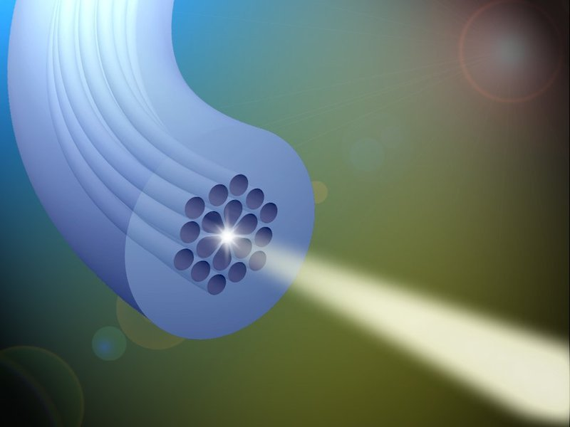

Any Question ??
Thanks to all
IT-12019 IT-12043

